Slide 1
TOUR BANGLA
- AN ONLINE TOURIST COMMUNITY

Slide 2
BY
1. Mustahsinul Moula Siam (1005064)
2. Md. Abdullah-Al-Maruf (1005066)
3. Md. Hasan Jawad (1005069)
4. Md. Jawad-Noor-Asif (1005080)
5. Md. Monzurul Amin Ifath (1005085)

Slide 3
Contents
Subsystems
Actors
Actor Glossary
According to each subsystems
Use-case Glossary
Use-case Diagram
Use-case Narrative with
-High level table version &
-Documentation

Slide 4
SUBSYSTEMS
ADMIN
USER SUBSYSTEM
GROUP ACTIVITIES
GENERAL INTERECTION
COMMERCIAL CLIENT MANAGEMENT

Slide 5
ACTORS
GENERAL USER
REGISTERED USER
ADMIN
HOTEL COMPANIES
TRANSPORT COMPANIES
TRAVEL AGENCIES

Slide 6
ACTORS GLOSSARY
ACTORS | SHORT-KEY | ACTIVITY SCOPE
ADMIN | ADM | Approval,verification,edition,modification,moderation,communication
REGISTERED USER | RU | Photo sharing , review & rating , blogging , suggestion, discussion , creating groups , event management
GENERAL USER | GU | Sign up , FAQ
HOTEL COMPANIES | HCM | Advertisement
TRANSPORT COMPANIES | TCM | Advertisement
TRAVEL AGENCIES | TA | Event management , offering package

Slide 7
1. ADMIN : USECASE GLOSSARY
Use-Case ID>NAME | Description | Participant actors and Roles
1.1>approval | Approving operations of premium & regular user | ADM approves operations of RU, HCM,TCM,TA
1.2>verification | Verifying operations of premium & regular user | ADM verifies operations of RU, HCM,TCM,TA
1.3>Modification & moderation | Modify & Delete contents | ADM modifies & deletes operations of RU, HCM,TCM,TA

Slide 8
1. ADMIN : USECASE GLOSSARY
Use-Case ID>NAME | Description | Participant actors and Roles
1.4>communication | Take user feedback & communication with clients | ADM takes feedback from RU,GU & communicate with HCM,TCM,TA
1.5>polling | Creating poll , voting, counting votes | ADM creates voting poll for RU , GU

Slide 9
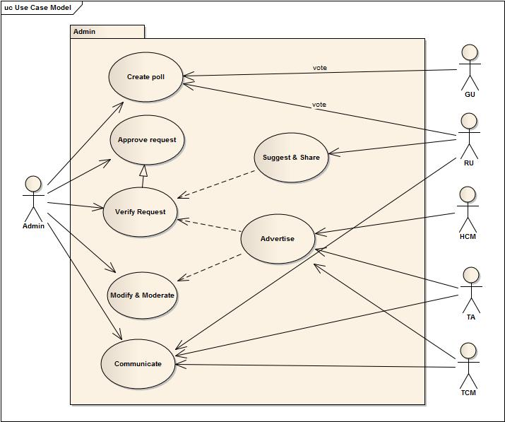
Use case diagram

Slide 10
2.User subsystem: Use case glossary
Use-Case ID>NAME | Description | Participant actors and Roles
2.1> creating profile | Creating profiles with detail info & updating | GU,HCM,TCM,TA creates & updates profile , ADM approves
2.2> photo sharing | Sharing photos & tagging users and places | RU shares & tags photos
2.3> polling | voting | RU , GU votes on the voting poll, ADM counts
2.4> review writing | writes review on places, hotels , transports | RU writes reviews on places , hotels, transports
2.5> rating | Place rating , hotel rating, transport rating | RU rates on places , hotels, transports
2.6> suggestion | Suggesting new places | RU suggests new places , ADM verifies and approves

Slide 11
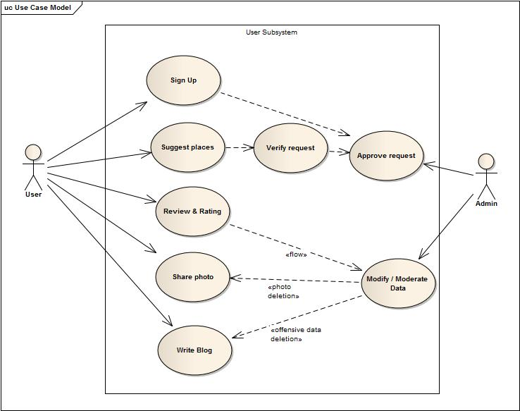
Use case diagram

Slide 12
3.Group activities: Use case glossary
Use-Case ID>NAME | Description | Participant actors and Roles
3.1> group management | Create groups , invite & add members, group chatting | RU creates groups , invites , add and chat with others RU
3.2> event management | Create & manage event , invite members in event | RU ,TA creates and manages events

Slide 13
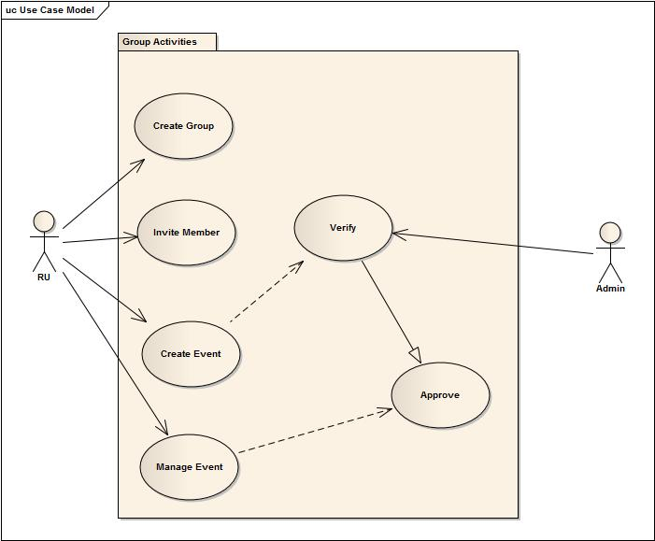
Use case diagram

Slide 14
3.1 Group management
Use Case Name | Define Route & Price
Use Case Id | 3.1
Priority | Medium
Primary Business Actor | RU
Other participating actor | RU,ADM
Description | Creating groups , adding , chatting
Trigger | RU
Table: Use-Case Narrative: Group management

Slide 15
Typical Course Of Events
Actor action | System response
Step 1: Registered user starts a group of any name | Step 2: Admin verifies and approves (auto verification in general)
Step 3: RU add and invite other members | Step 4: A group is created

Slide 16
3.2 Event management
Use Case Name | Define Route & Price
Use Case Id | 3.2
Priority | Medium
Primary Business Actor | RU,TA
Other participating actor | RU,TA,ADM
Description | Creating & managing events
Trigger | RU,TA
Table: Use-Case Narrative: Event management

Slide 17
Typical Course Of Events
Actor action | System response
Step 1: RU or TA fill up a specific form providing information about the event | Step 2: Approved/canceled by ADM
Step 3: Invite members if approved by ADM | Step4 : Further modification by ADM (if necessary)

Slide 18
4.General interaction: Use case glossary
Use-Case ID>NAME | Description | Participant actors and Roles
4.1> discussion | Threading , posting comment | RU writes thread and posts comments
4.2> shout box activity | chatting , system notification | RU chats with other members and ADM announces notifications

Slide 19
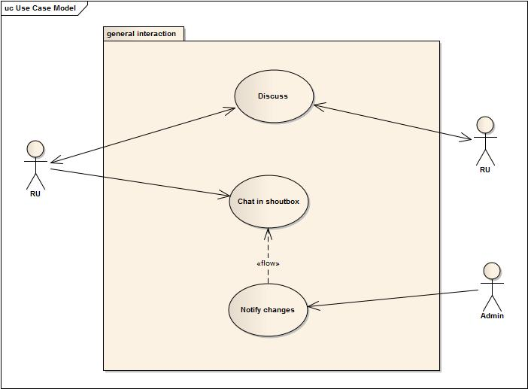
Usecase diagram

Slide 20
4.1 Discussions
Use Case Name | Define Route & Price
Use Case Id | 4.1
Priority | Medium
Primary Business Actor | RU
Other participating actor | RU,ADM
Description | Writing threads & posting comments
Trigger | RU
Table: Use-Case Narrative: Discussion

Slide 21
Typical Course Of Events
Actor action | System response
Step 1: RU opens a thread | Step 3: Other RU responses by comments, opinion
Step 3: Discussion goes on

Slide 22
4.2 Shout-box Activity
Use Case Name | Define Route & Price
Use Case Id | 4.2
Priority | Medium
Primary Business Actor | RU,ADM
Other participating actor
Description | Chatting & announcing notifications
Trigger | RU,ADM
Table: Use-Case Narrative: Shout-Box-Activity

Slide 23
Typical Course Of Events
Actor action | System response
Step 1: RU chats with other RU | Step 2: Notify any changes/new information about the system if necessary

Slide 24
5.Commercial client subsystem : Use case glossary
Use-Case ID>NAME | Description | Participant actors and Roles
5.1> creating premium accounts | Creates premium accounts | HCM,TCM,TA creates premium accounts and ADM approves
5.2> advertising | Advertise features | HCM, TCM,TA advertise their features , ADM verifies
5.3> offering packages | Offers packages relating hotels, transports | HCM,TCM,TA offer their packages , ADM verifies
5.4> serving guides | Serve guides to help | HCM,TA appoints guides

Slide 25
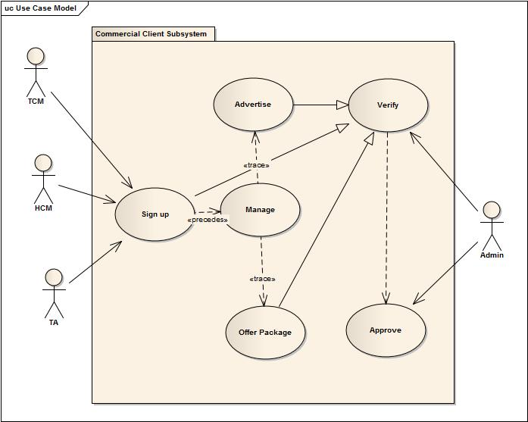
Usecase diagram

Slide 26
…THANK YOU…

